Slide 1
Rapid IoT Application Development using the Web of Things
Second W3C Workshop on the Web of Things
4 June 2019
Kunihiko Toumura
Research and Development Group
Hitachi, Ltd.

Slide 2
1. Current Issues in IoT Application Development
To connect things beyond their domain and platform,
we must go through the barrier of interoperability.
Cross-platform
IoT Application
Barriers against
cross-platform
collaboration
ambiguous
specification
SDKs for
limited env.
Closed
specification
Proprietary
protocol
IoT
Platform A
IoT
Platform B
IoT
Platform C
IoT
Platform D
Notes:
silo,

Slide 3
2. Web of Things Thing Description
WoT Thing Description describes each IoT Platform and Things,
and Applications use the TD as an open specification of each PF or Things.
Cross-platform
IoT Application
WoT Thing Description
General Metadata
Interaction Affordances
Data Schemas
Public Security Configuration
IoT
Platform A
IoT
Platform B
IoT
Platform C
IoT
Platform D
Protocol Binding(s)
Notes:
silo,

Slide 4
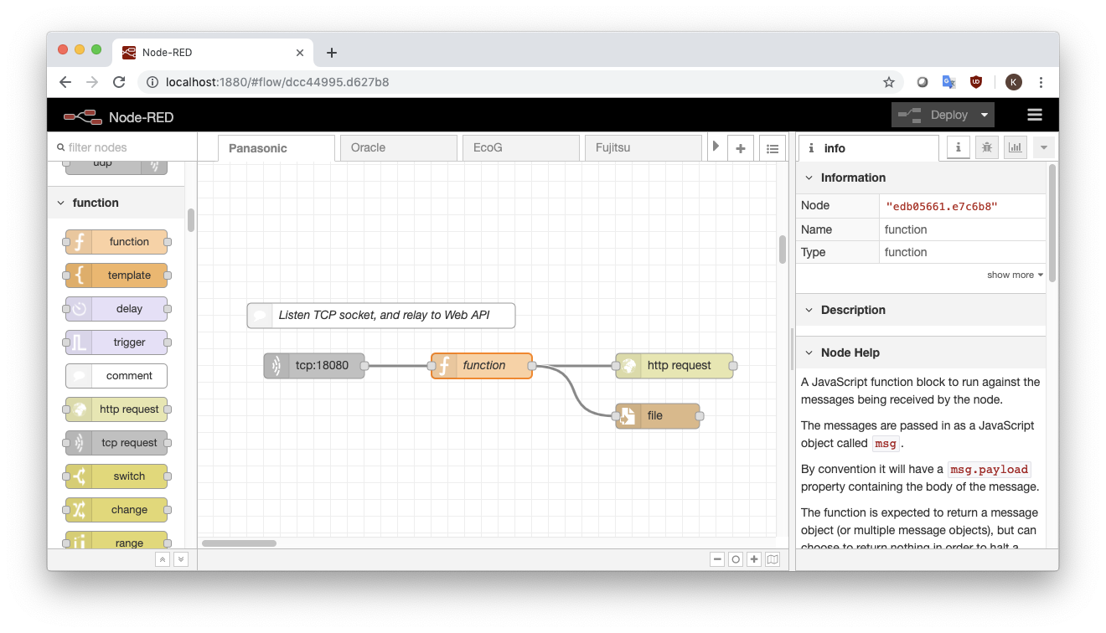
3. Rapid IoT Application Development Environment
Node-RED is widely used in IoT application development field,
because of its intuitive programming user interface.
Node-RED is a flow-based programming environment for IoT application.
Developing application is simple: place and connect the “nodes”.

Slide 5
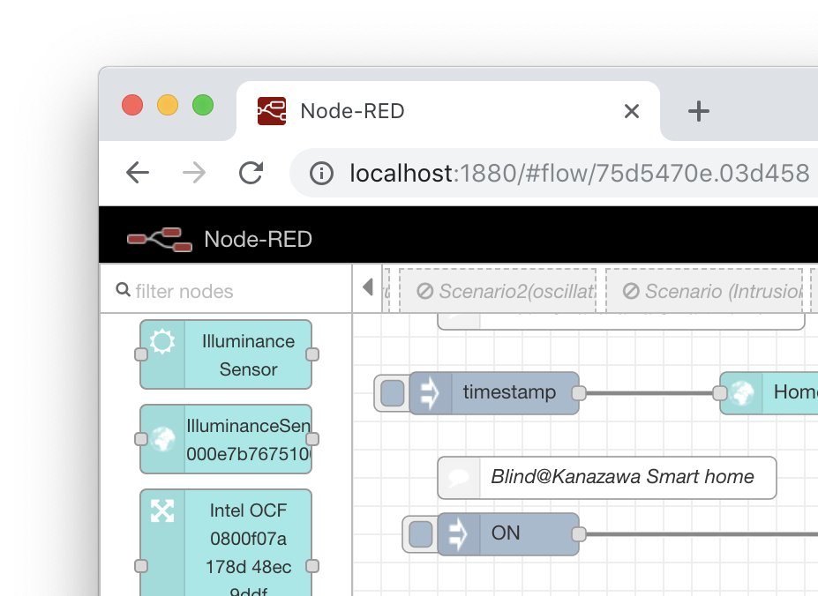
3. Combine Node-RED with the Web of Things
“Node Generator” simplifies IoT application development
by generating Node module of Node-RED from a Thing Description
By generating a Node, developer can handle a Node as an avatar of a Thing.
To write a property of the Thing, send message and its payload will be written.
To read a property, send a message as a trigger, and then the Node emit a message which contains a value of the property.
WoT Thing Description
Node
Generator
General Metadata
Interaction Affordances
Data Schemas
Public Security Configuration
Protocol Binding(s)

Slide 6
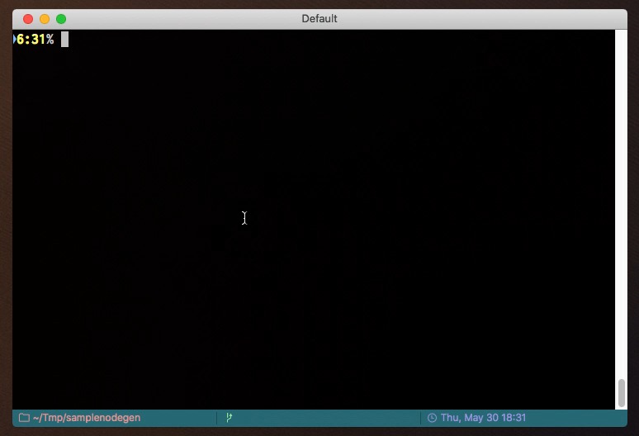
4-1. How to Use: Preparation
1. Clone repository
% git clone https://github.com/k-toumura/node-red-nodegen.git
% cd node-red-nodegen
% git checkout webofthings
2. Install dependent packages
% npm install
3. Run node-red-nodegen
% ./bin/node-red-nodegen.js

Slide 7
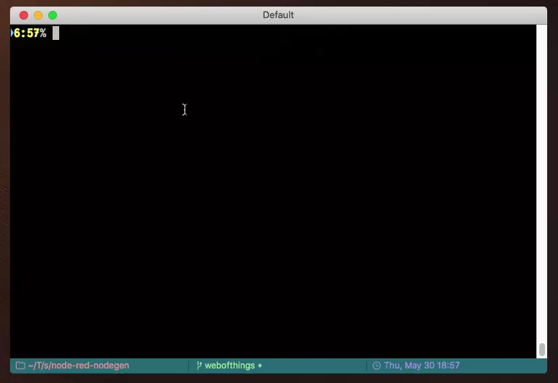
4-2. How to Use: Generate and Install a Node Module
1. Generate a Node module
% ./bin/node-red-nodegen td.jsonld
2. Install dependent packages
% cd ~/.node-red
% npm install
generated-module-dir
3. Run Node-RED
% node-red

Slide 8
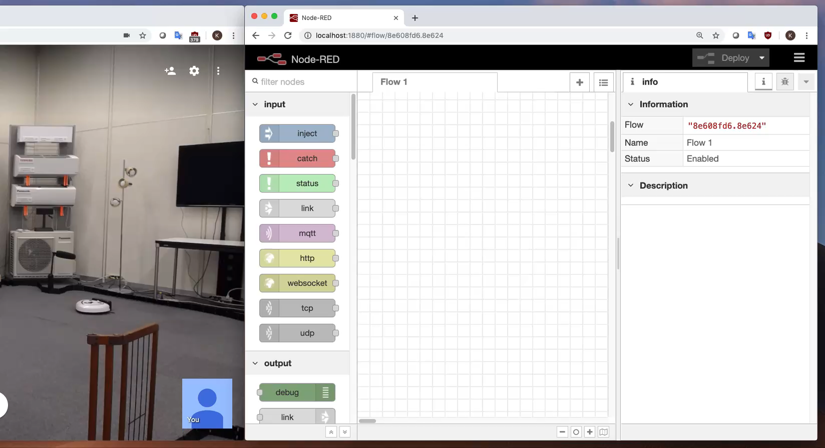
4-3. How to Use: Write a Simple Application

Slide 9
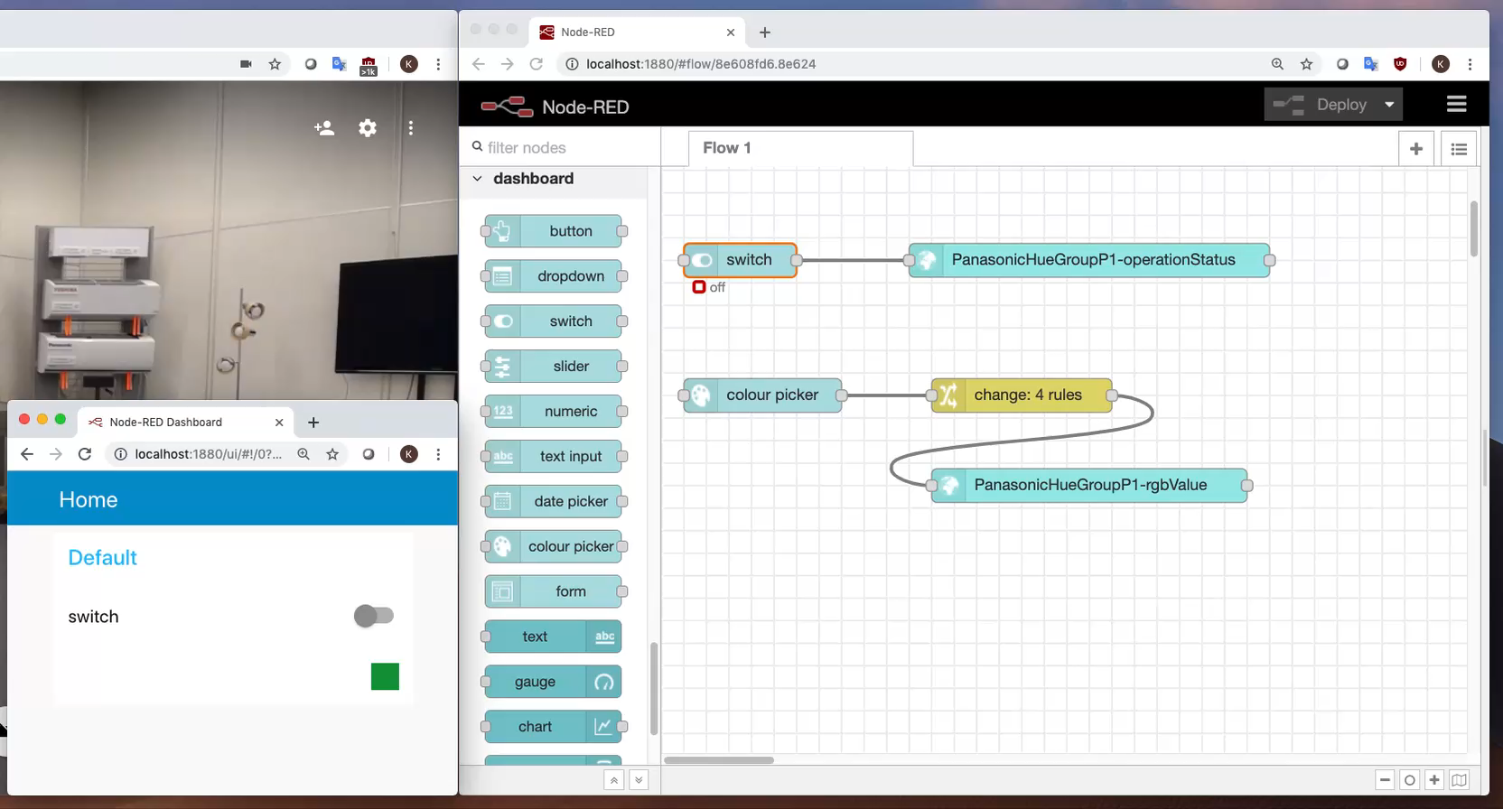
4-4. How to Use: Control the Thing using Dashboard

Slide 10
5. Benefit of Node Generator
Simplify device integration process in IoT Application Development
Developers need not to care about details of network protocol to interact with Things.
Detailed information is encapsulated in Thing Description, and Node Generator use them to generate specific protocol binding codes.
Developers can get appropriate information of Things from Editor UI.
need not to search another document separately
can concentrate to implement logics that create real customer values.

Slide 11
6. Current Issue and Future Directions
Semantic Metadata may gain Developer’s Productivity
Semantic search/discovery of Thing Description
Recommend a related Node in Node-RED Editor UI
Automatic reconciliation of message content between Nodes
Eliminate boilerplate coding for connecting Things
Utilize Web links to incorporate other useful information of Things on Editor UI.
Manuals, pictures, contact person, support forum, etc.

Slide 12
END
Rapid IoT Application Development using the Web of Things
Second W3C Workshop on the Web of Things
4 June 2019
Kunihiko Toumura
Research and Development Group
Hitachi, Ltd.

Slide 13
Notes:
本日は有難うございました。

